Slide 1

NATIONAL UNIVERSITY OF MODERN LANGUAGES
Faculty of Engineering and Computing
Department of Software Engineering

Slide 2

SOFTWARE DESIGN AND ARCHITECTURE
LECTURE NO. 5
Introduction to Software Engineering Design
Course Instructor: | Mr. Ahsan Arif
 | Lecturer Department of Software Engineering NUML Islamabad
Date: October 09, 2024
Software Engineering Design: Theory and Practice

Slide 3
LECTURE CONTENTS
  Class Diagrams (Logical View)
  Elements of a CLASS diagram
  Relationship between classes
  Making Class diagrams
    Example
Date: October 09, 2024
Software Engineering Design: Theory and Practice

Slide 4
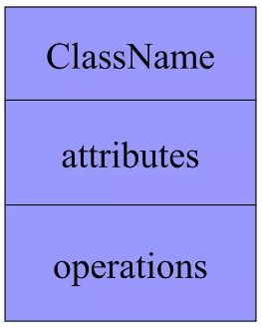
UML – CLASS DIAGRAM
A class is a description of a set of objects that share the same attributes, operations, relationships, and semantics.
Graphically, a class is rendered as a rectangle, usually including its name, attributes, and operations in separate, designated compartments.
Date: October 09, 2024
Software Engineering Design: Theory and Practice
Notes:
Class diagrams model the static behavior of objects, i.e.
Attributes of objects
Operation of objects
Relationships between objects.

Slide 5
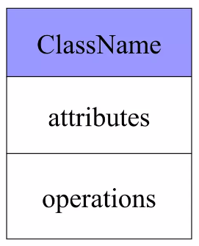
CLASS NAME
  The name of the class is the only required tag in the graphical representation of a class.
  It always appears in the top-most compartment.
Date: October 09, 2024
Software Engineering Design: Theory and Practice
Notes:
In a class diagram, the class name is the only essential element. Other elements like attributes and operations can be added for more detail but are not mandatory.

Slide 6
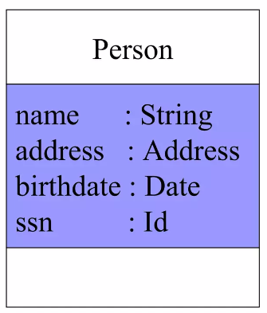
CLASS ATTRIBUTES
  An attribute is a named property of a class that describes the object being modeled.
  In the class diagram, attributes appear in the second compartment just below the name compartment.
Date: October 09, 2024
Software Engineering Design: Theory and Practice
Notes:
Confusion about the Address and Date data types in the Person class:
Why use Address instead of a simple String for the address?
Complexity: An address is more than just a string. It typically includes street address, city, state, zip code, and possibly country. Using a String to represent all these components would make it difficult to manage and validate the address data.
Reusability: By creating a separate Address class, you can encapsulate the logic for handling addresses, such as validation, formatting, and calculations. This makes the code more reusable and easier to maintain.
Encapsulation: Using an Address class allows you to hide the internal representation of an address from the Person class, making the Person class less complex and easier to understand.
Why use Date instead of a String for the birthdate?
Validation: A Date class can provide built-in validation to ensure that the date entered is valid (e.g., checking for correct day, month, and year).
Calculations: A Date class can also provide methods for performing date calculations, such as calculating age, determining if a date is in the past or future, and formatting dates in different ways.
Consistency: Using a Date class ensures that dates are stored and manipulated consistently throughout the application, reducing the risk of errors.

Slide 7
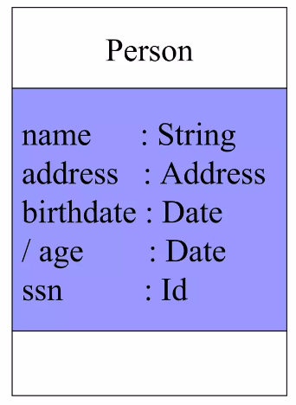
CLASS ATTRIBUTES (Cont’d)
  Attributes are usually listed in the form:
  attributeName: Type
  A derived attribute is one that can be computed from other attributes, but doesn’t actually exist. For example, a Person’s age can be computed from his birth date. A derived attribute is designated by a preceding ‘/’ as in:
  / age : Date
Date: October 09, 2024
Software Engineering Design: Theory and Practice

Slide 8
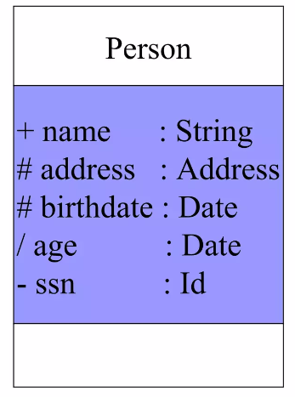
CLASS ATTRIBUTES (Cont’d)
  Attributes can be:
    + public
    # protected
    - private
Visibility symbols are used to determine the accessibility of the information contained in classes.
Date: October 09, 2024
Software Engineering Design: Theory and Practice
Notes:
Public: This method can be called any where, any time
Private: This method can only be called by other methods in this class
Protected: This method can be called by other methods in this class, or by other methods in child classes.
The access modifiers are listed according to their restrictiveness order.
1) private (accessible within the class where defined)
2) default or package-private (when no access modifier is specified)
3) protected (accessible only to classes that subclass your class directly within the current or different package)
4) public (accessible from any class)

Slide 9
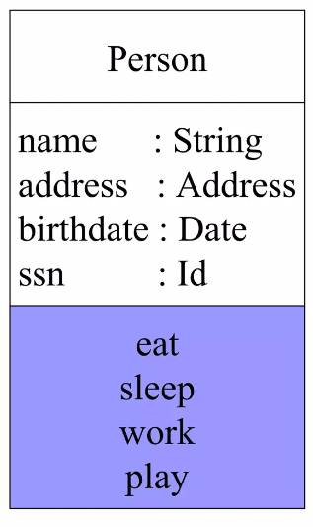
CLASS OPERATIONS
  Operations describes the class behavior and appear in the third compartment.
Date: October 09, 2024
Software Engineering Design: Theory and Practice

Slide 10
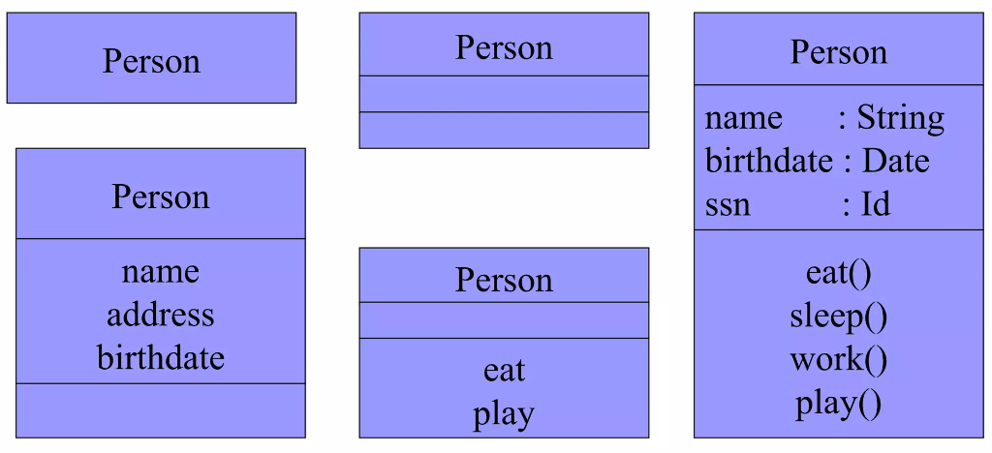
DEPICTING CLASSES
When drawing a class, you needn’t show attributes and operation in every diagram.
Date: October 09, 2024
Software Engineering Design: Theory and Practice

Slide 11
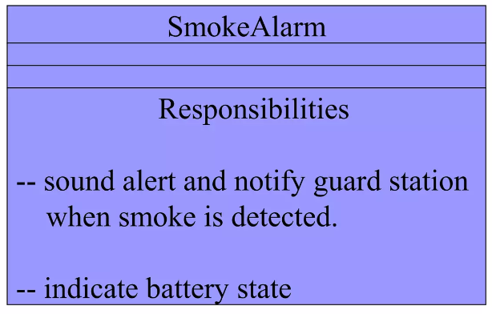
CLASS RESPONSIBILITIES
A class may also include its responsibilities in a class diagram.
A responsibilities is a contract or obligation of a class to perform a particular services.
Note: there can be a fourth section (responsibility), which is an optional section for including additional information about the class.
Date: October 09, 2024
Software Engineering Design: Theory and Practice

Slide 12
Relationships between classes
Classes are interrelated to each other in specific ways. In particular, relationships in class diagrams include different types of logical connections. The following are such types of logical connections that are possible in UML:
Dependency
Association
    Aggregation
    Composition
Multiplicity
Inheritance/Generalization
Date: October 09, 2024
Software Engineering Design: Theory and Practice

Slide 13
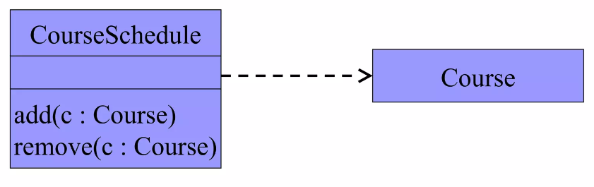
Relationships – Dependency
A dependency indicates a semantic relationship between two or more elements. The dependency from CourseSchedule to Course exists because Course is used in both the add and remove operations of CourseSchedule.
Date: October 09, 2024
Software Engineering Design: Theory and Practice

Slide 14
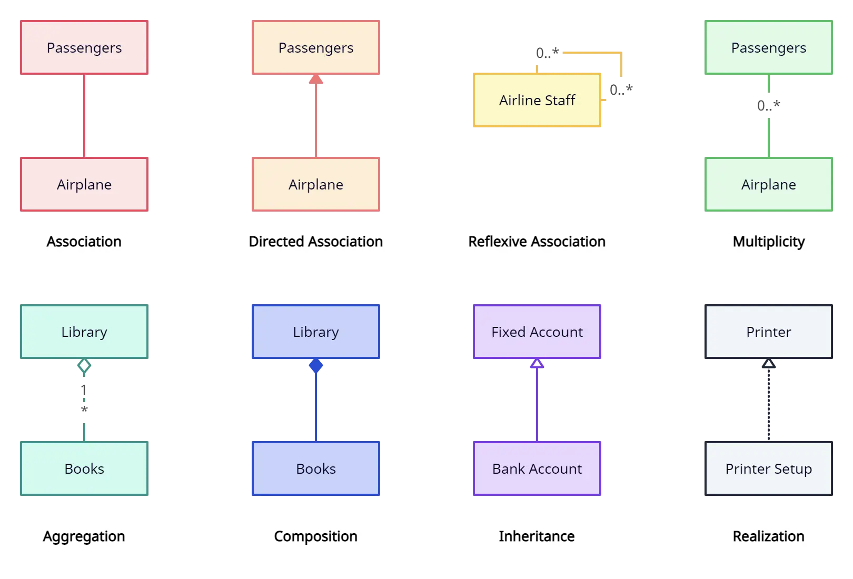
Relationships – Association
Bidirectional / Association
A bilateral association is represented by a straight line connecting two classes. It simply demonstrates that the classes are aware of their relationship with each other.
Unilateral / Direct Association
A unilateral association is represented by an open arrowhead connecting one class to another. It shows that one class is aware of its relationship with another class.
Date: October 09, 2024
Software Engineering Design: Theory and Practice

Slide 15
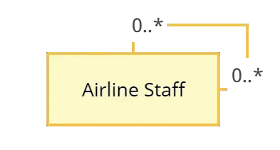
Relationships – Association
Reflexive Association
This occurs when a class may have multiple functions or responsibilities. For example, a staff member working in an airport may be a pilot, aviation engineer, ticket dispatcher, guard, or maintenance crew member. If the maintenance crew member is managed by the aviation engineer there could be a managed by relationship in two instances of the same class.
Date: October 09, 2024
Software Engineering Design: Theory and Practice

Slide 16
Association - Aggregation and Composition
Aggregation and Composition are subsets of association meaning they are specific cases of association. In both aggregation and composition object of one class “owns” object of another class. But there is a subtle (understated) difference: Aggregation implies a relationship where the child can exist independently of the parent. Example: Class (parent) and Student (child). Delete the Class and the Students still exist. Composition implies a relationship where the child cannot exist independent of the parent. Example: House (parent) and Room (child). Rooms don’t exist separate to a House.
Date: October 09, 2024
Software Engineering Design: Theory and Practice

Slide 17
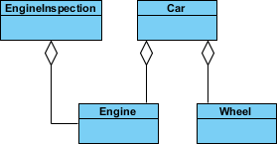
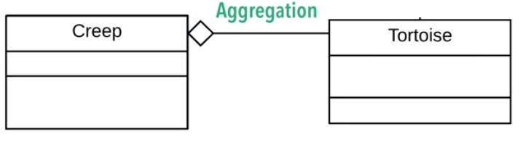
Aggregation
A special form of association that models a whole-part relationship between an aggregate (the whole) and its part.
Models a “is a part-part of” relationship.
Date: October 09, 2024
Software Engineering Design: Theory and Practice

Slide 18
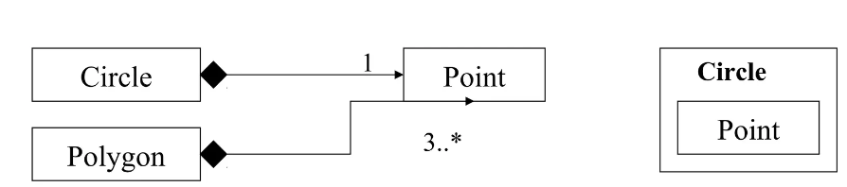
Composition
A strong form of aggregation.
  The whole is the sole owner of its part.
    The part object may belong to only one whole.
Multiplicity on the whole side must be zero or one.
The life time of the part is dependent upon the whole.
The composite must manage the creation and destruction of its parts.
Date: October 09, 2024
Software Engineering Design: Theory and Practice

Slide 19
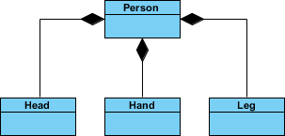
Composition (Cont’d)
Date: October 09, 2024
Software Engineering Design: Theory and Practice

Slide 20
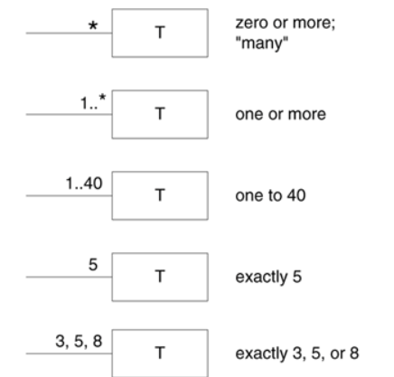
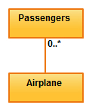
Multiplicity
is the active logical association when the cardinality of a class in relation to another is being depicted. For example, one commercial airplane may contain zero to many passengers. The notation 0..* in the diagram means “zero to many”.
Date: October 09, 2024
Software Engineering Design: Theory and Practice

Slide 21
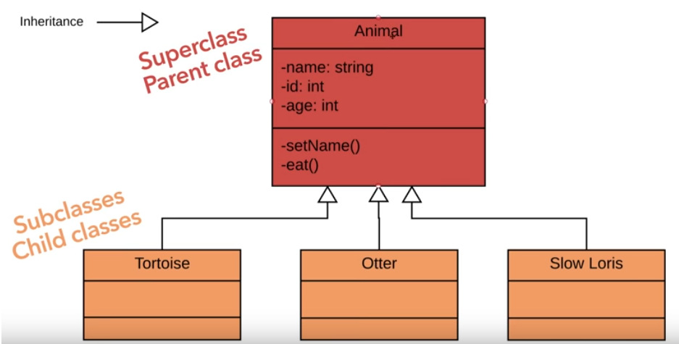
Relationships between classes
Inheritance /Generalization
Relation between a general class (super class) and more specific class also called a sub-class (a class that refines super class)
Date: October 09, 2024
Software Engineering Design: Theory and Practice
Notes:
In UML class diagrams, an abstract class is a class that cannot be instantiated and is typically used as a base class for other classes that will provide the implementation.

Slide 22
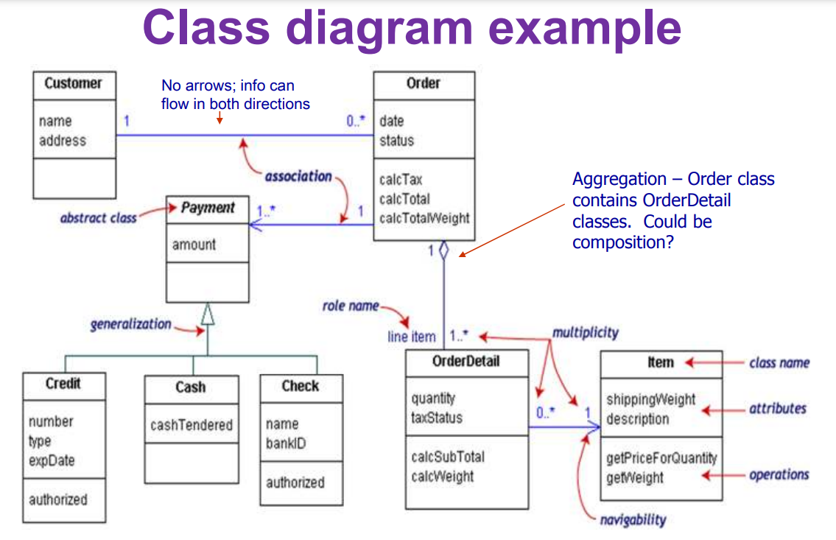
Example
Date: October 09, 2024
Software Engineering Design: Theory and Practice
Notes:
In the given class diagram, the relationship between Order and OrderDetail should be modeled as composition. This indicates that an Order cannot exist without its OrderDetails.

Slide 23
References
https://creately.com/guides/class-diagram-relationships/#reflexive-association
https://www.slideshare.net/Nadia_Nazeer/class-diagrams-64840010
https://slideplayer.com/slide/8318914/
Date: October 09, 2024
Software Engineering Design: Theory and Practice

Slide 24
Thank You...
Mr. Ahsan Arif
Lecturer (Dept. of Software Engineering)
ahsanarif.se42@gmail.com
Date: October 09, 2024
Software Engineering Design: Theory and Practice

